Slide 1
Projects
VISHWARUPA BASAK
BRANCH-INFORMATION TECHNOLOGY

Slide 2
My Progress-
I am presently working in the field of Full Stack Web Development
I have been into learning html,css,jquery,js,mysql,ajax,handlebars.
I am presently learning python and Django.
I have started with a few projects which work is present on git hub(https://github.com/vishwabasak41/HR-projects
I have my work files deployed on ‘python-anywhere’
I have done one project of making a complete website on local django development server.
I have created a URL-shortener website
I have created a basic MVP landing page based on an oonine tutorial.
*working on a udacity project to create an e-commerce website and hence learning ORM languages like SQLAlchemy.
I have designed several other web pages all for learning purposes.
I have attached in the following sites screenshots of some of my work done.
Presesntly i am working on a blogsite building project using python and Django.
In the speed recruitment process i actively participated in designing the registration forms at my college.

Slide 3
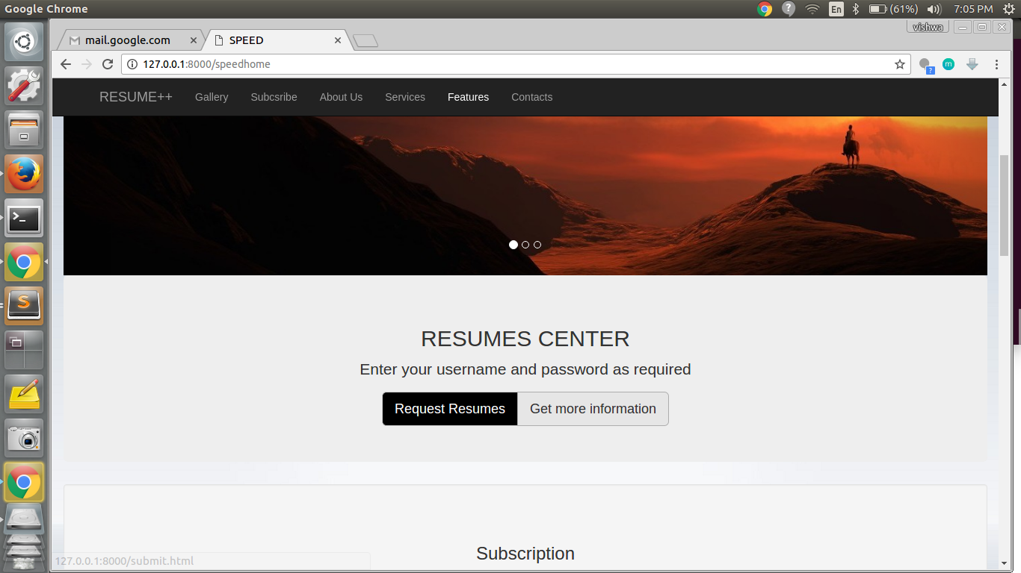
WORK DONE-

Slide 4
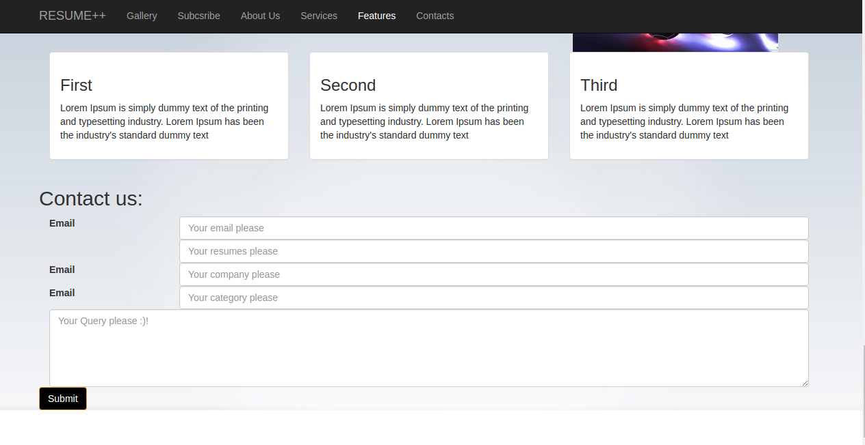
WORK DONE-

Slide 5
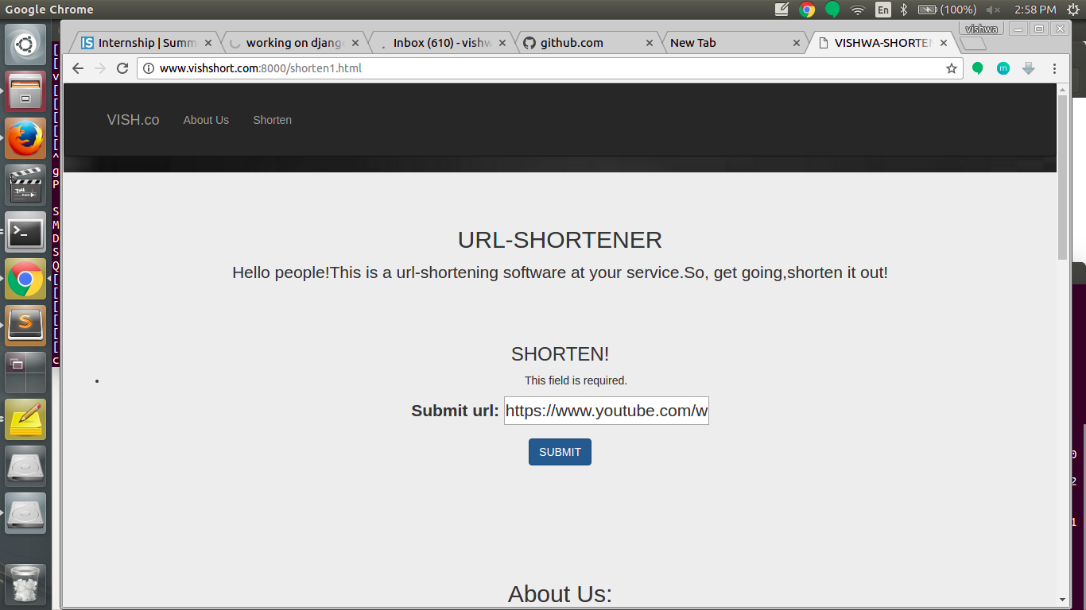

Slide 6
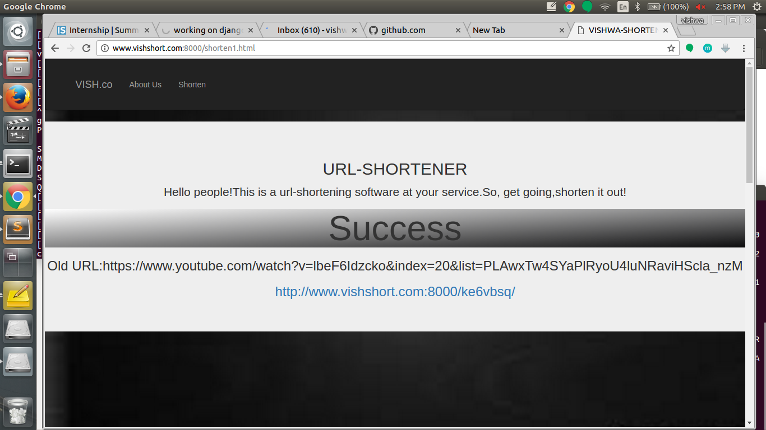

Slide 7
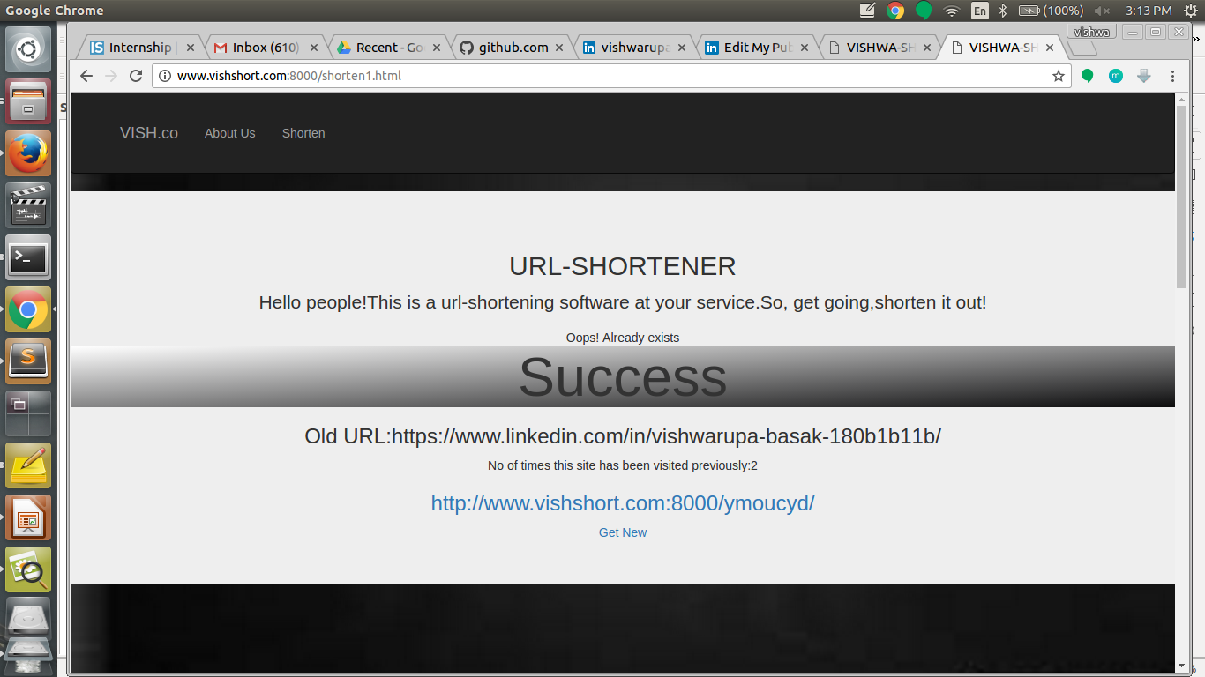

Slide 8
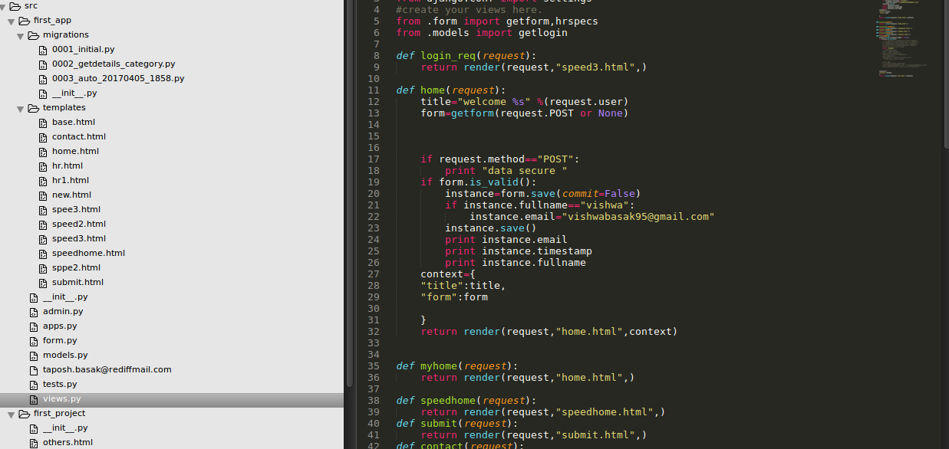
WORK DONE-

Slide 9
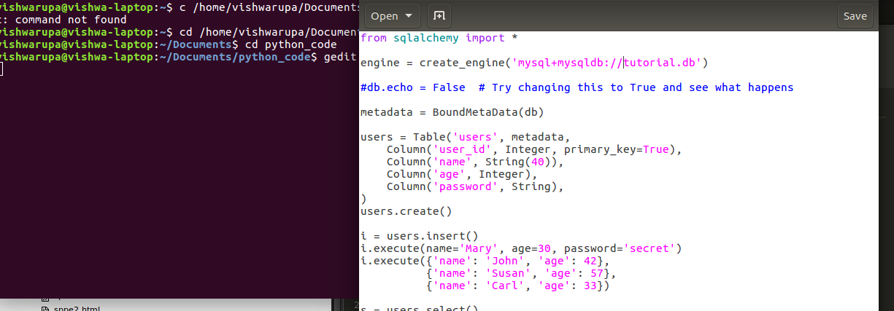
WORK DONE-
e-comm project

Slide 10
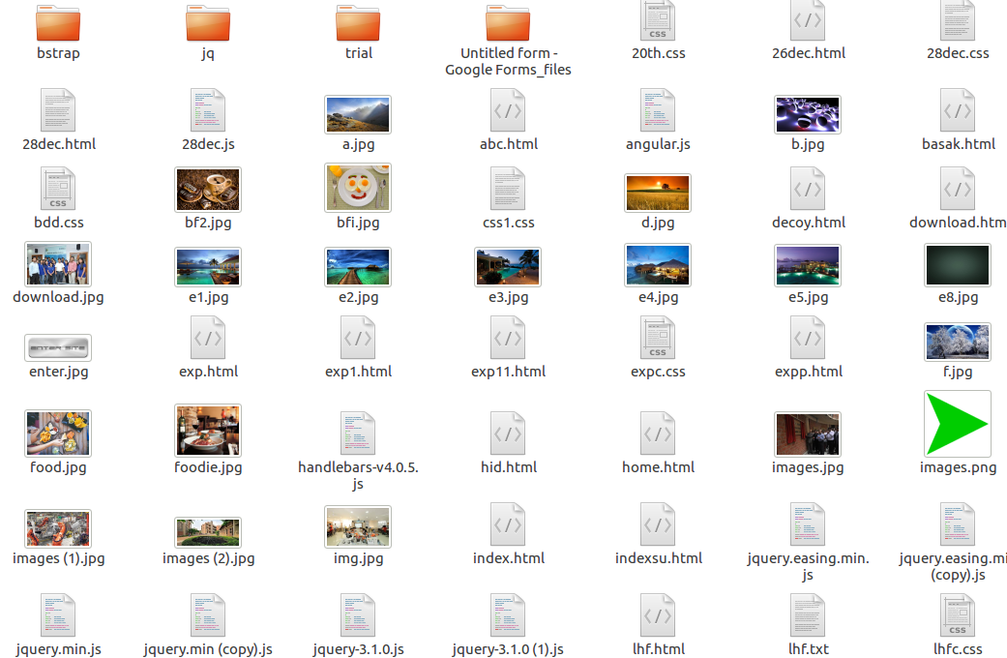
WORK DONE-

Slide 11
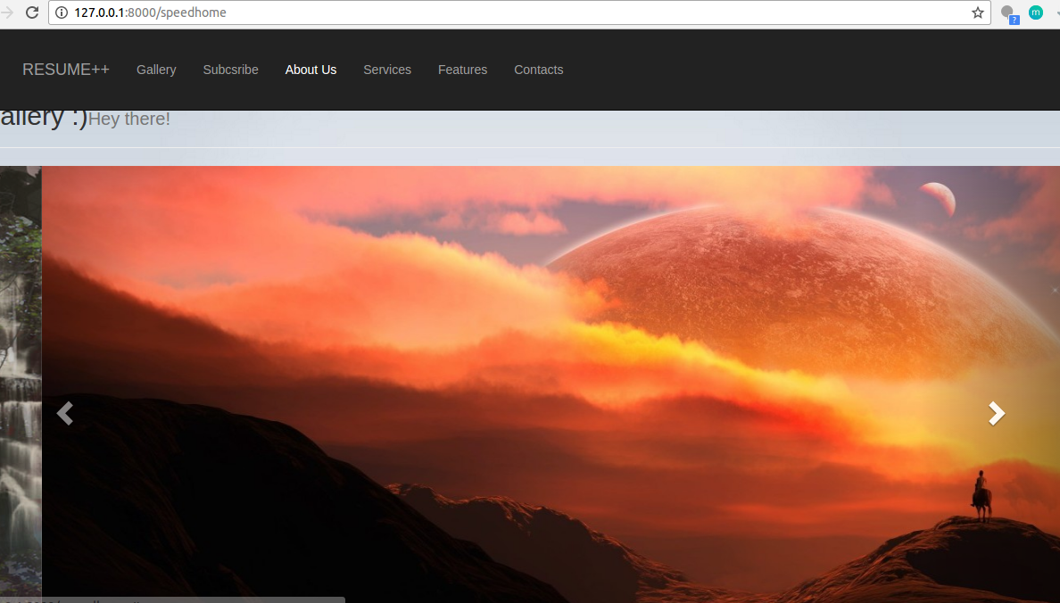

Slide 12
THANKYOU

